Slide 1
Heart Disease-Prediction
Miss. Dhanashri Parameshwar Chavan

Slide 2
Problem Statement
Heart disease is a leading cause of death.
The major risk factors for heart disease is
1) High blood pressure
2) High Cholesterol
3) Smoking
Other key indicators include diabetes staus high BMI
not getting enough physical activity or driking too
much alcohol
The application of machine learning methods to detect patterns in the data that can predict a patient’s condition.

Slide 3
Flow of The Project
Missing Values Treatment
Data Types Conversion
Model Building-1
First Data-Frame
Class Imbalance
Outliers
Visualization
Model Builing-2
Second Data-Frame
Feature Selection
Model Builing-3
Third Data-Frame
Conclusion

Slide 4
About the Dataset
Data-shape
Rows - 38571
Columns - 18
Target Column – HeartDisease
Categorical Target Column

Slide 5
Data Preprocessing
Missing Values Treatment
Data types conversion - LabelEncoder Transform

Slide 6
First Data-Frame Conclusion – xgBoost is the best fitted Model
 | Model Name | Accuracy | TPR | FPR | F1_score
1 | LG | 91.924822 | 0.988886 | 0.896211 | 0.957564
2 | DT | 86.830849 | 0.918120 | 0.726524 | 0.927318
3 | RF | 91.691510 | 0.986353 | 0.917628 | 0.955437
4 | SVM | 92.132210 | 0.999437 | 0.991763 | 0.959093
5 | KNN | 92.145172 | 0.885903 | 0.650741 | 0.912609
6 | NB | 84.368114 | 1.0 | 1.0 | 0.959050
7 | AdaBoost | 87.051199 | 0.921216 | 0.729819 | 0.928860
8 | xgBoost | 91.808166 | 0.985369 | 0.869852 | 0.956831

Slide 7
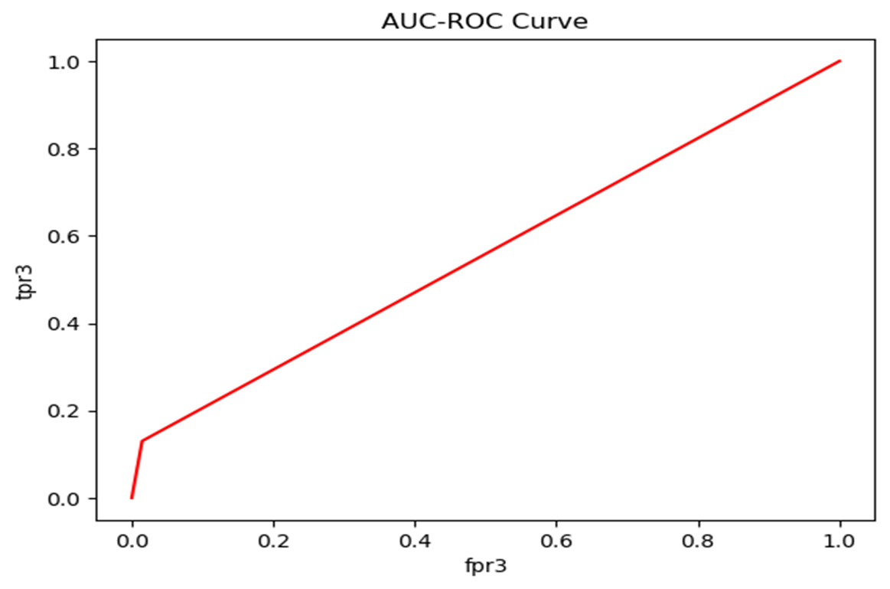
AUC-ROC Curve for xgBoost

Slide 8
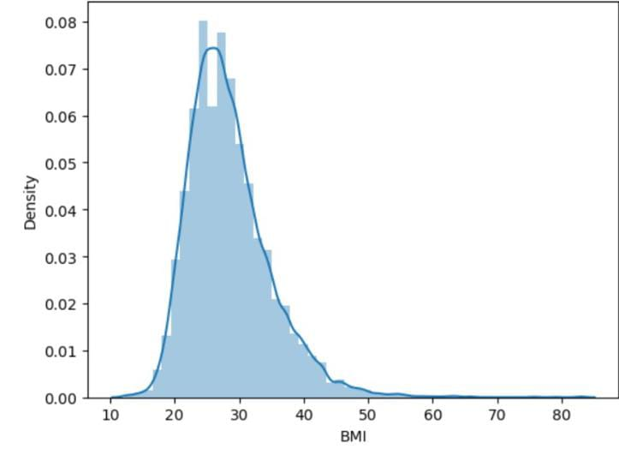
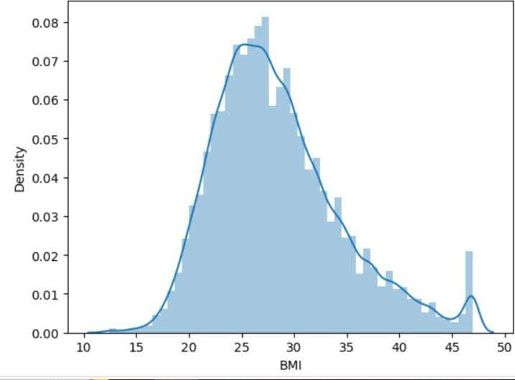
Class Imbalance
Over Sampling
BMI
Before Outlier After Outlier

Slide 9
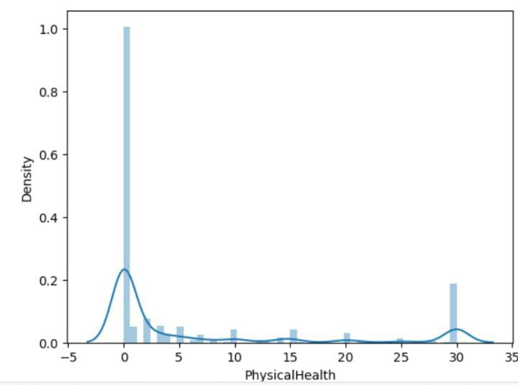
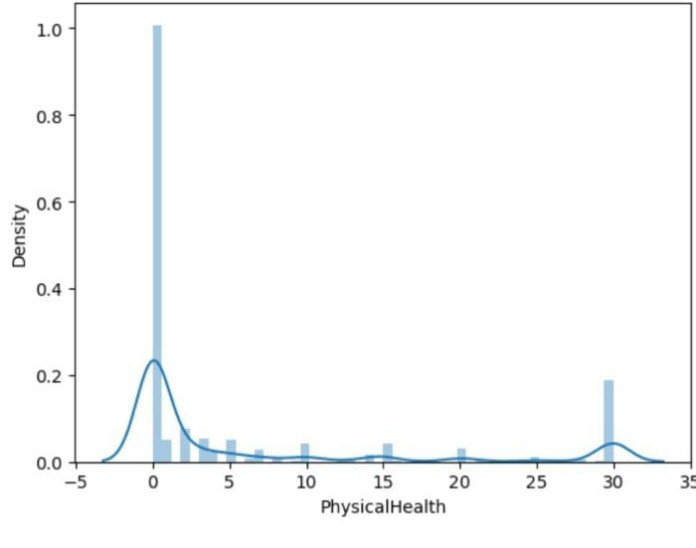
PhysicalHealth
Before Outlier After Outlier

Slide 10
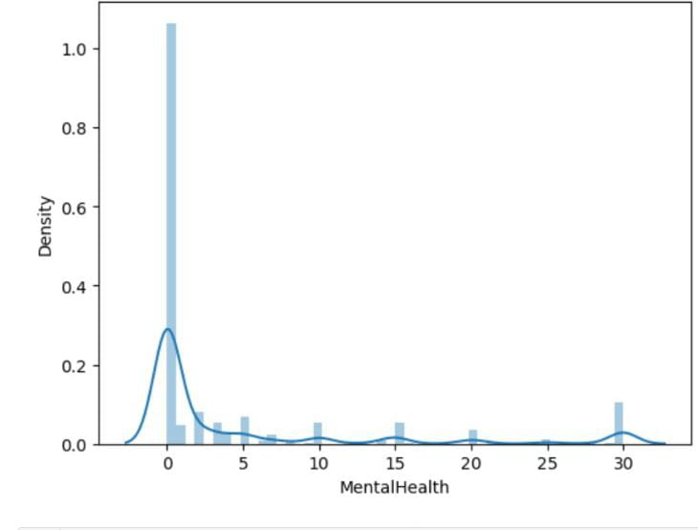
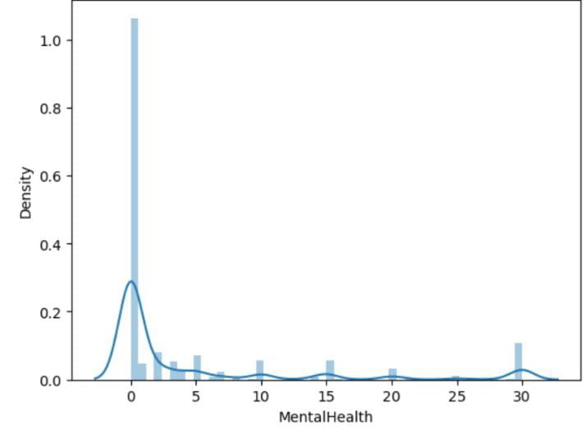
MentalHealth
Before Outlier After Outlier

Slide 11
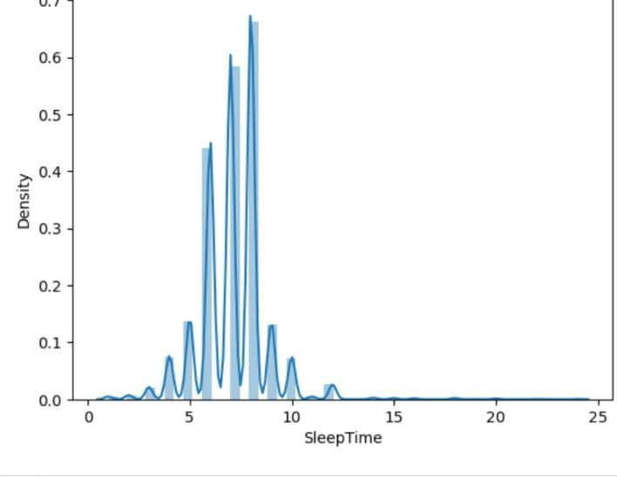
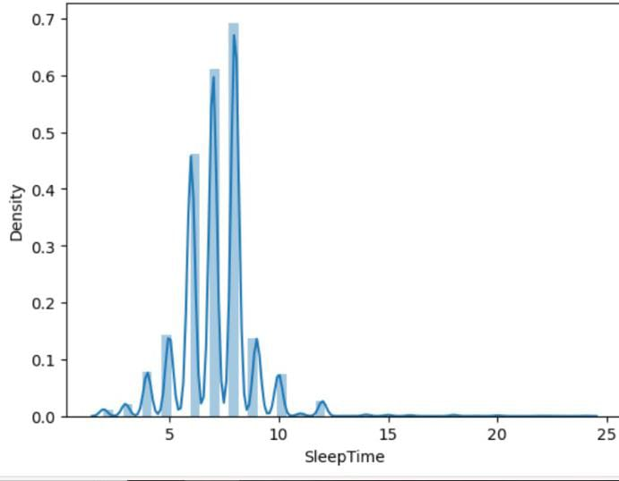
Sleep Time
Before Outlier After Outlier

Slide 12
Second Data-Frame
 | Model Name | Accuracy | TPR | FPT | F1_Score
1 | LG | 75.823322 | 0.740254 | 0.234371 | 0.749893
2 | DT | 95.978799 | 0.915254 | 1.0 | 0.955752
3 | RF | 97.745583 | 0.953738 | 0.000 | 0.977026
4 | SVM | 76.388693 | 0.721045 | 0.155163 | 0.721045
5 | KNN | 78.650177 | 0.821186 | 0.480339 | 0.713812
6 | NB | 66.515901 | 0.722175 | 0.199717 | 0.751635
7 | AdaBoost | 96.706714 | 0.926977 | 0.000283 | 0.961964
8 | xgBoost | 86.424028 | 0.815678 | 0.082320 | 0.859375
Conclusion – xgBoost is the best fitted model

Slide 13
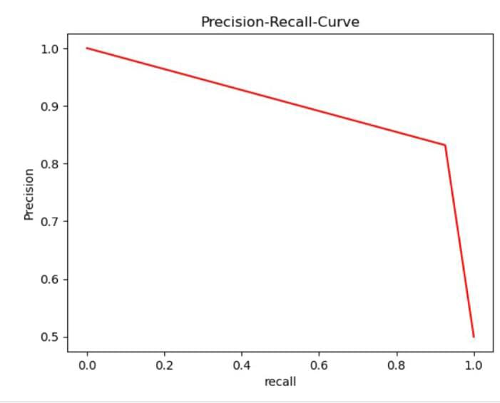
PRC Curve for xgBoost

Slide 14
Feature Engineering
Using RFE Method

Slide 15
Third Data-Frame
Conclusion – xgBoost is the best fitted Model
 | Model Name | Accuracy | TPR | FPR | F1_Score
1 | LG | 91.989631 | 0.997186 | 0.990155 | 0.958032
2 | DT | 86.377187 | 0.918261 | 0.782537 | 0.925159
3 | RF | 90.900843 | 0.978897 | 0.906093 | 0.952107
4 | SVM | 83.979261 | 0.883089 | 0.667216 | 0.910370
5 | KNN | 92.132210 | 1.00000 | 1.0000 | 0.959050
6 | NB | 92.119248 | 0.999578 | 0.927914 | 0.958969
7 | AdaBoost | 88.295528 | 0.936410 | 0.846787 | 0.932976
8 | xgBoost | 91.872975 | 0.990433 | 0.920932 | 0.957367

Slide 16
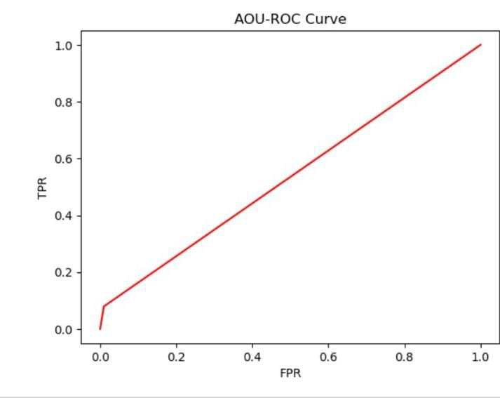
AUC-ROC Curve for xgBoost

Slide 17
Merits:
1.By using Machine Learning Algorithm we can easily predict
how many people are sufferning from HeartDisease
2.By using this algorithm prediction has become easy
Demerits:
1.One of the main challenges when using heart disease is ensuring the quality
and reliability of the data. Issues such as missing values, outerliers and inaccuracies
in data collection can lead to bias or incorrect prediction when training machine
learning models.
2.Due to class imbalance the number of positive cases patients without heart disease
is significantly lower than the negative cases patients without heart disease. This
imbalance can affect the performance of machine learning models.

Slide 18
THANK YOU

